Slide 1
11. Image Inpainting
2022-05-14
kts123@kookmin.ac.kr

Slide 2
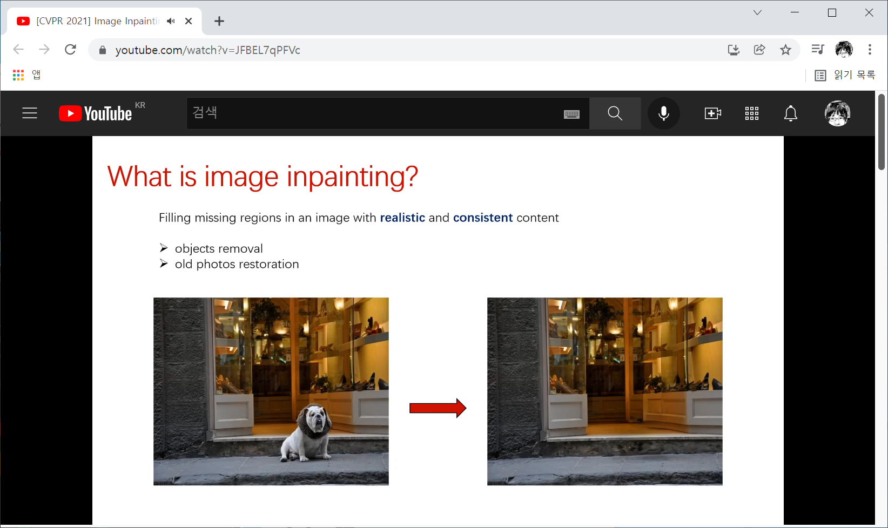
https://www.youtube.com/watch?v=JFBEL7qPFVc

Slide 3
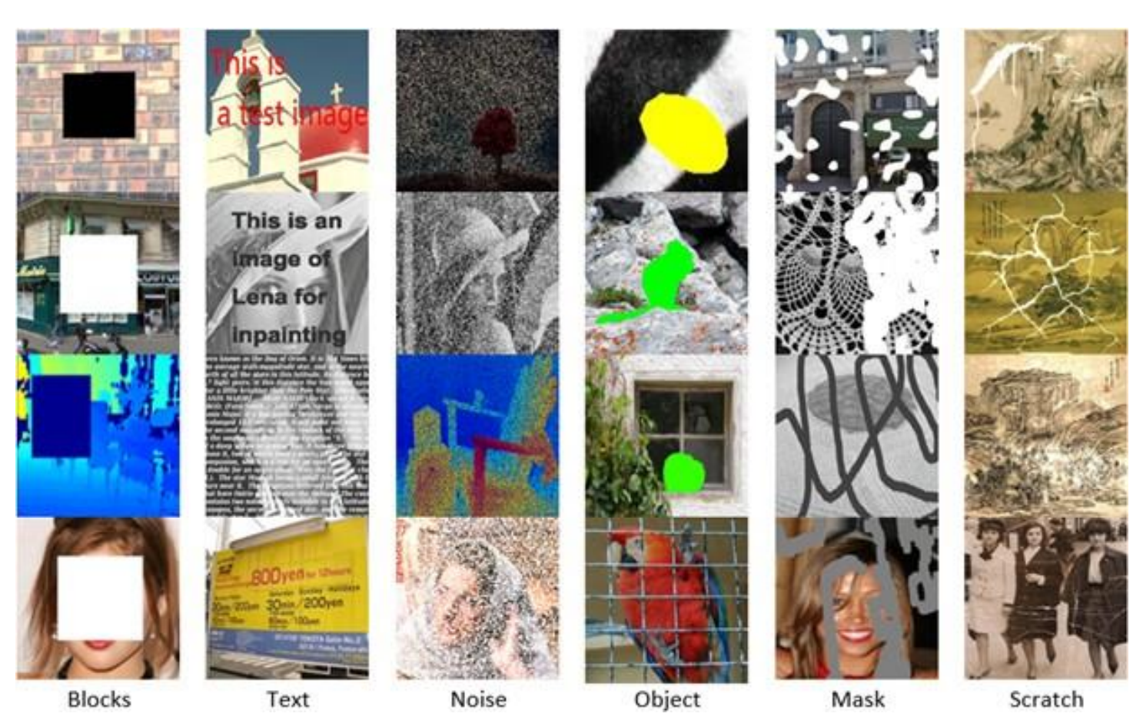
https://arxiv.org/ftp/arxiv/papers/1909/1909.06399.pdf

Slide 4
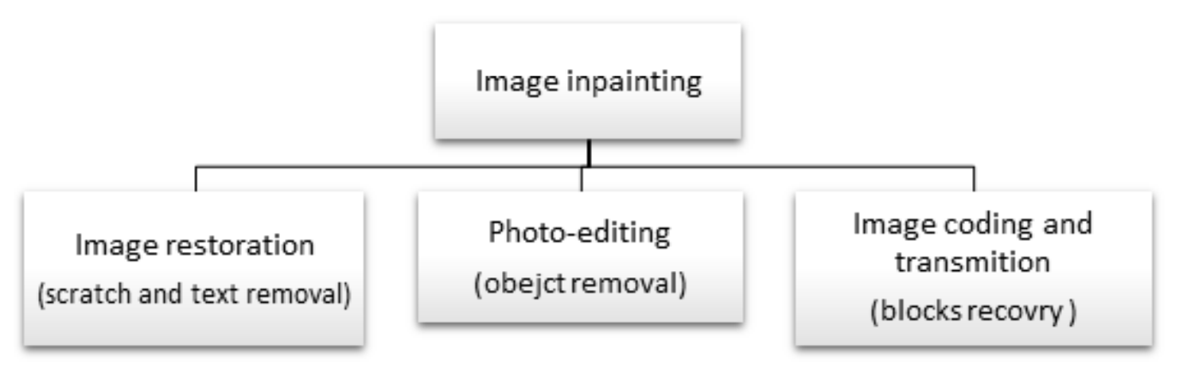
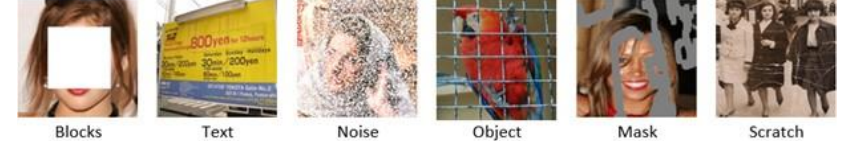
https://arxiv.org/ftp/arxiv/papers/1909/1909.06399.pdf

Slide 5
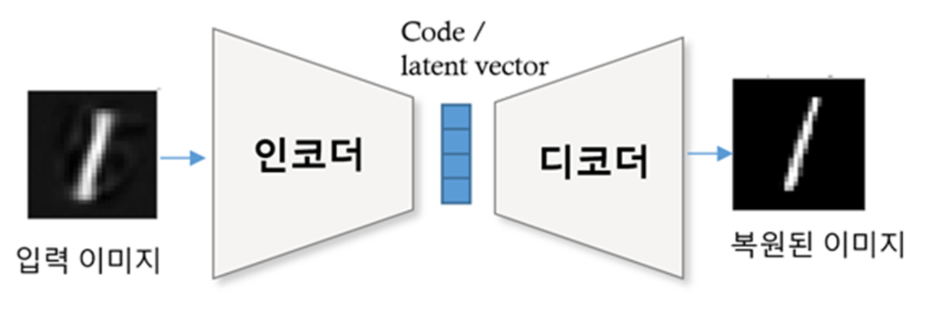
IT := Information Technology

Slide 6
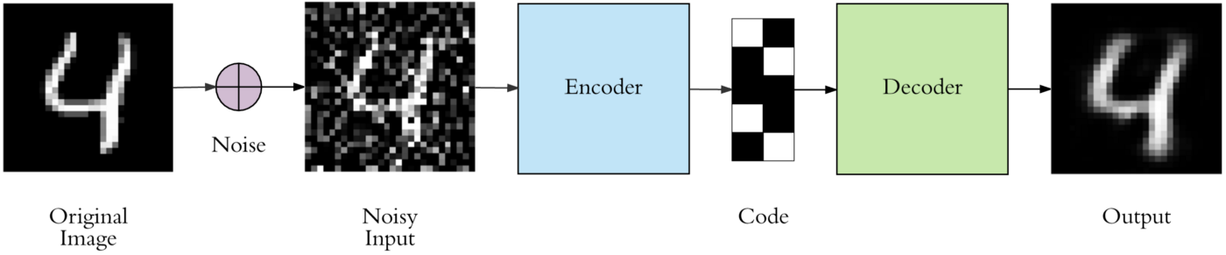
Denoising Autoencoder
https://towardsdatascience.com/applied-deep-learning-part-3-autoencoders-1c083af4d798

Slide 7
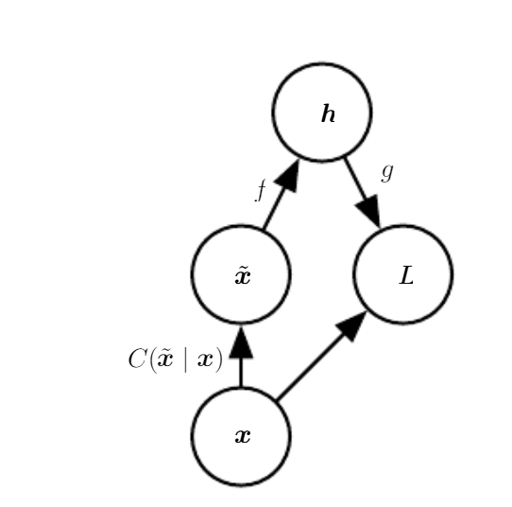
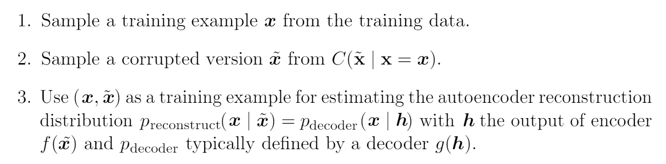
https://www.deeplearningbook.org/contents/autoencoders.html

Slide 8
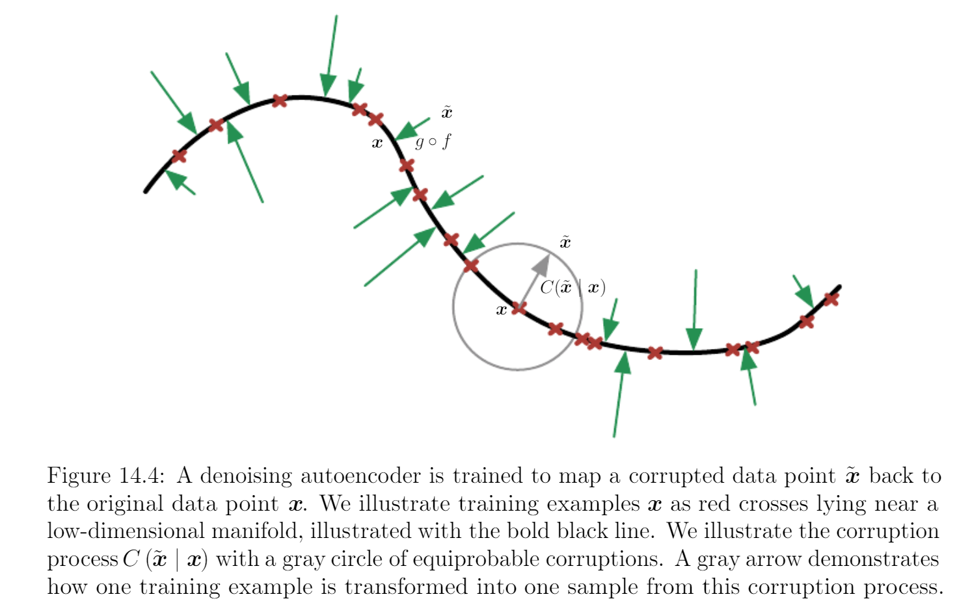
https://www.deeplearningbook.org/contents/autoencoders.html

Slide 9
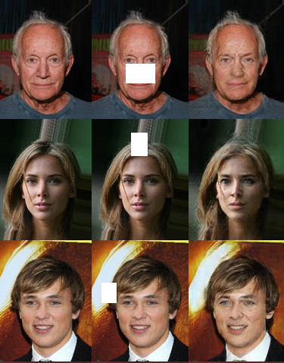
Generative Adversarial Denoising Autoencoder for Face Completion
https://faculty.cc.gatech.edu/~hays/7476/projects/Avery_Wenchen/

Slide 10
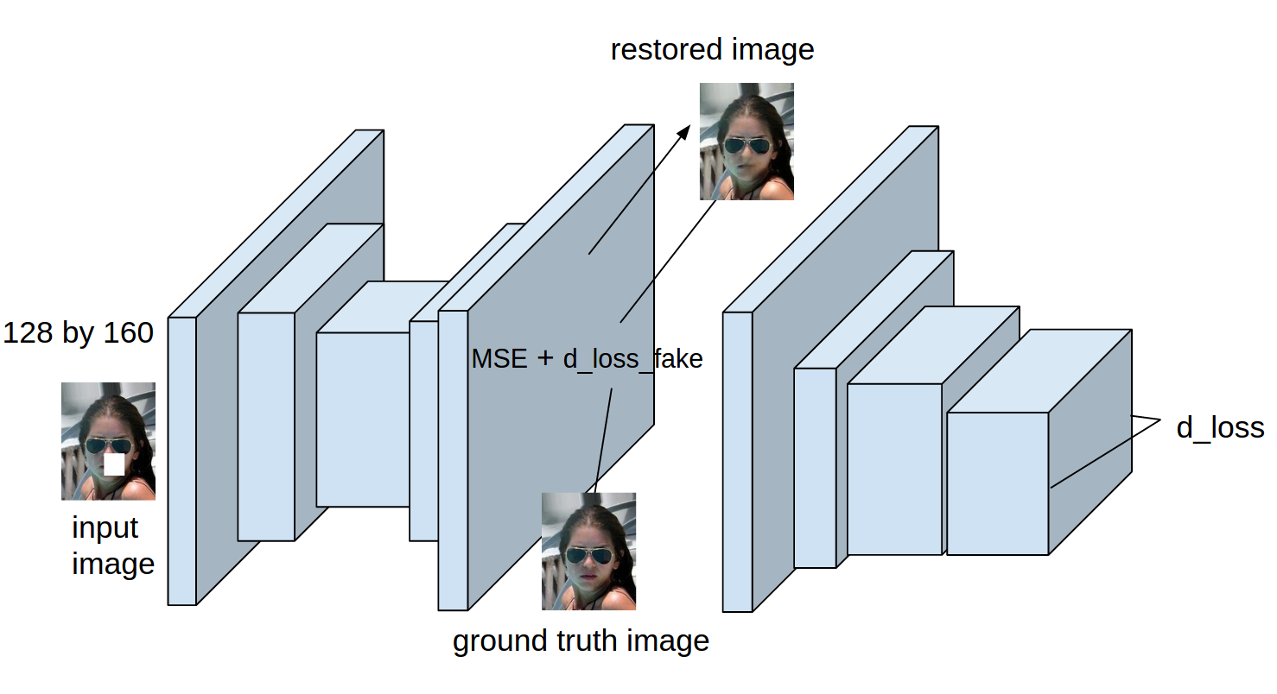
https://faculty.cc.gatech.edu/~hays/7476/projects/Avery_Wenchen/

Slide 11


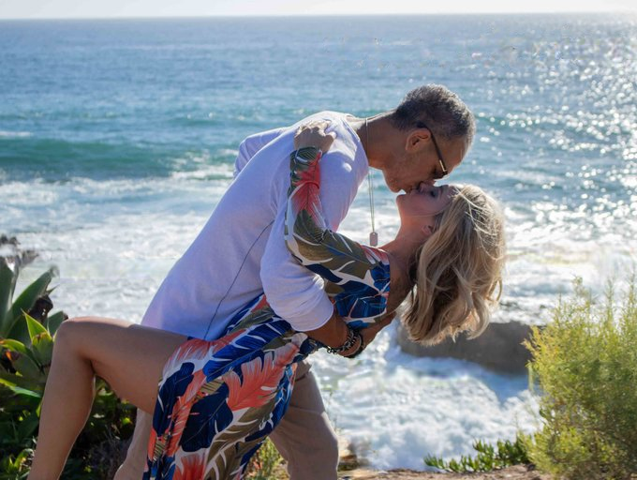
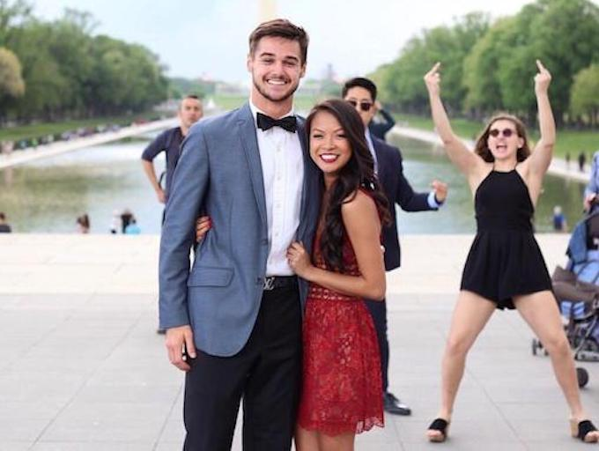
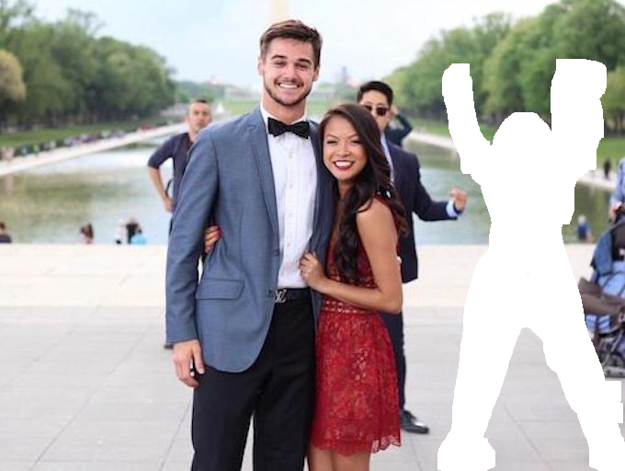
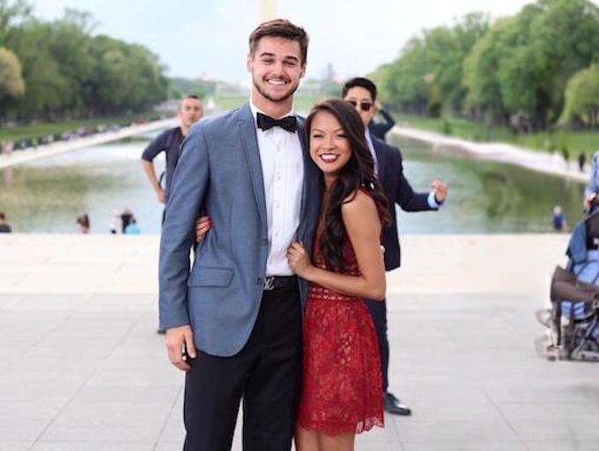
Generative Image Inpainting with Contextual Attention
https://github.com/JiahuiYu/generative_inpainting

Slide 12
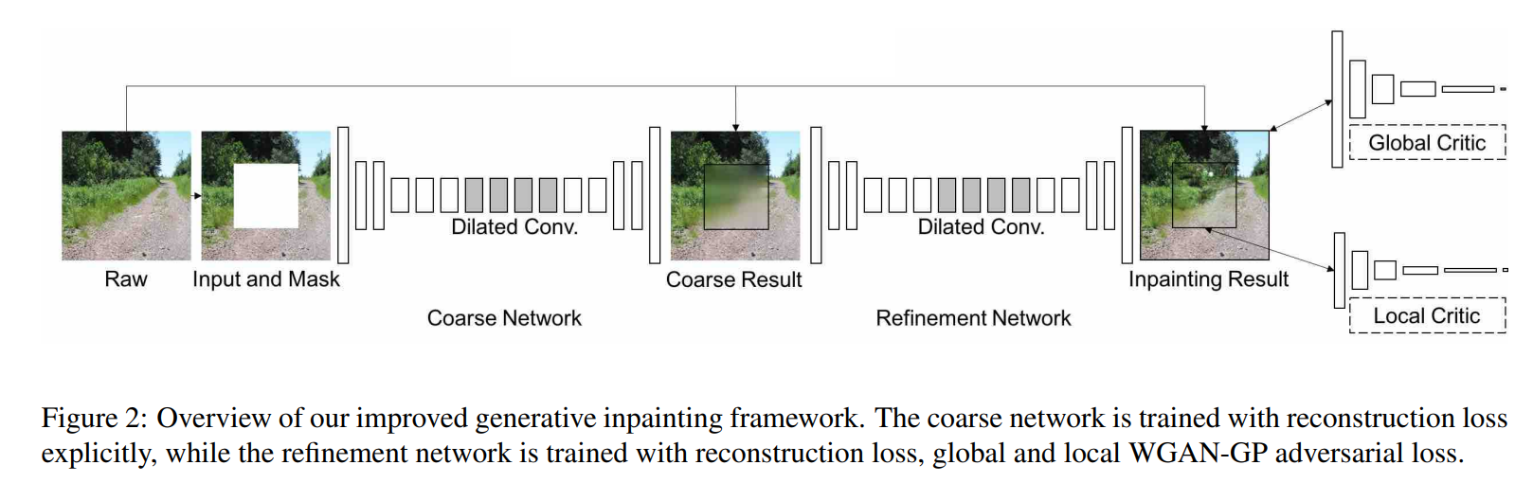






Generative Image Inpainting with Contextual Attention
https://github.com/JiahuiYu/generative_inpainting

Slide 13
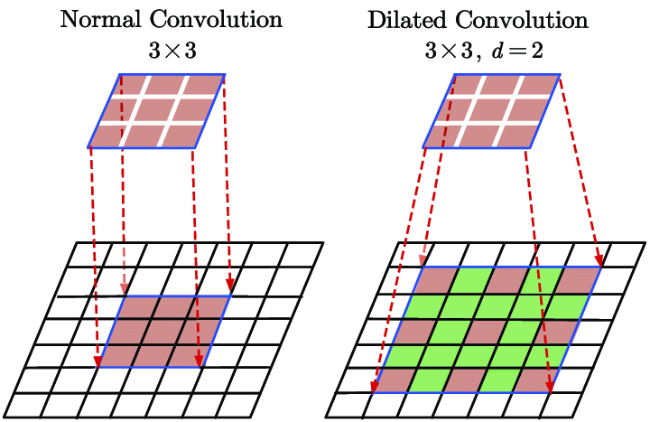
https://www.researchgate.net/figure/The-illustration-of-the-2D-dilated-convolution-with-spatial-size-of-33-and-dilation_fig1_338780378

Slide 14
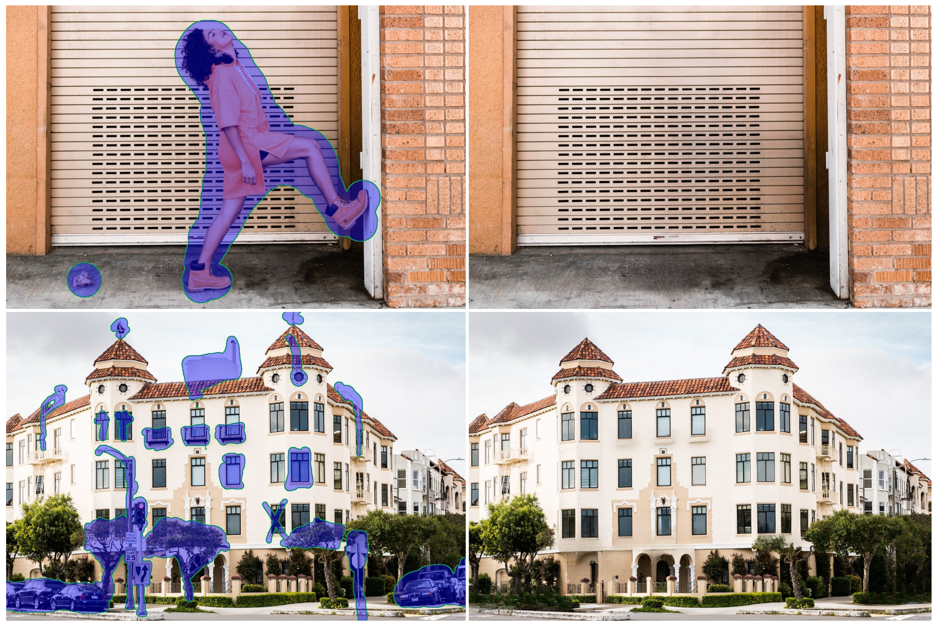
Resolution-robust Large Mask Inpainting with Fourier Convolutions
https://saic-mdal.github.io/lama-project/

Slide 15
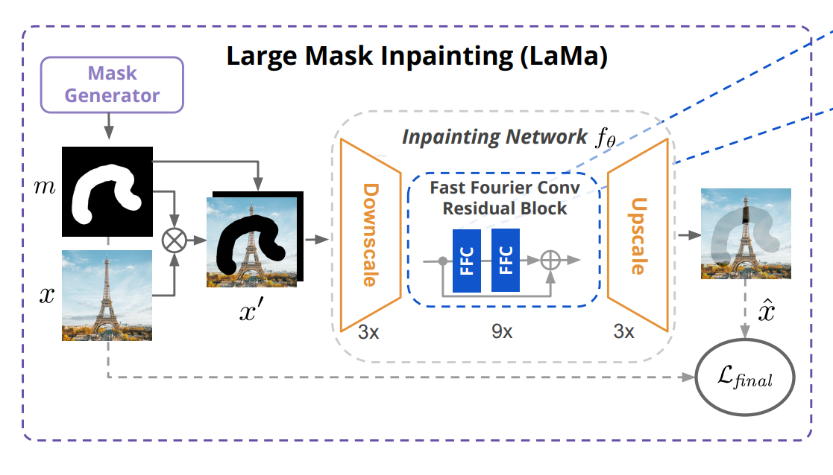
https://saic-mdal.github.io/lama-project/

Slide 16
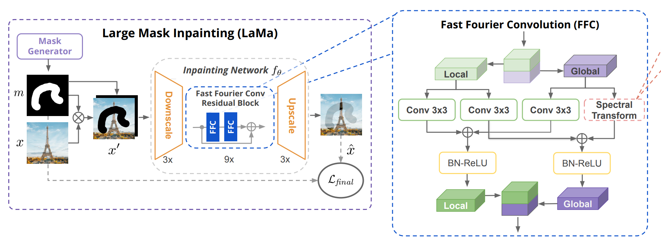
https://saic-mdal.github.io/lama-project/

Slide 17
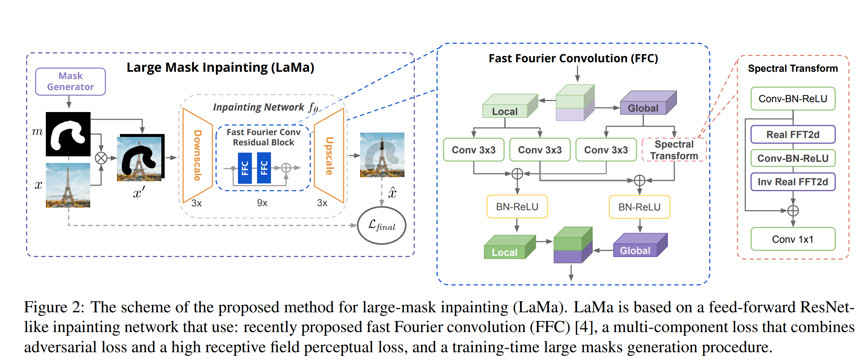
https://saic-mdal.github.io/lama-project/

Slide 18

animated gif image
https://saic-mdal.github.io/lama-project/

